Slide 1
Audit Observations

Slide 2
Site Audit Pictures
The following slides contain pictures from site audits which represent a specific section question in the SPI-RRT checklist
For each picture,
  Give an audit score based on the quality standards,
  Identify the best practices and non-conformities
  Recommend some corrective actions where applicable

Slide 3
Physical Facility
The testing site is adequate to provide a safe and effective HTC services

Slide 4
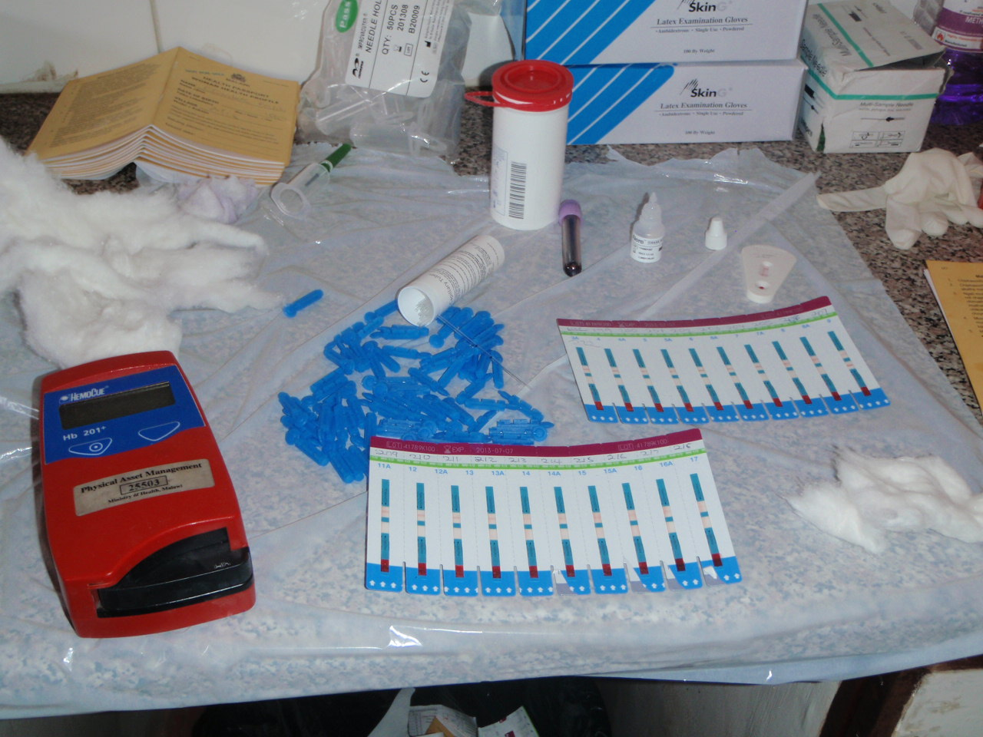
2.2

Slide 5
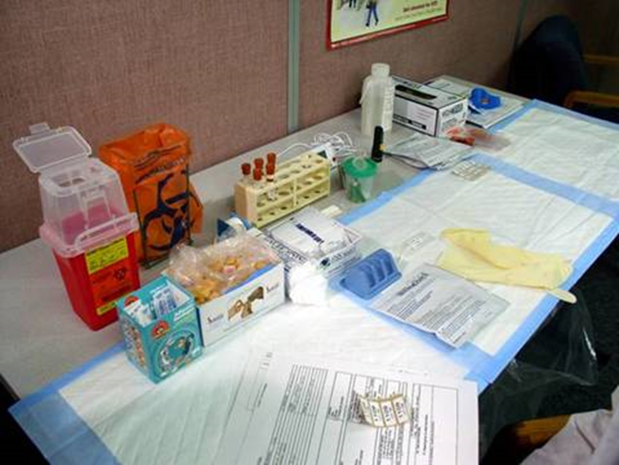
2.2

Slide 6
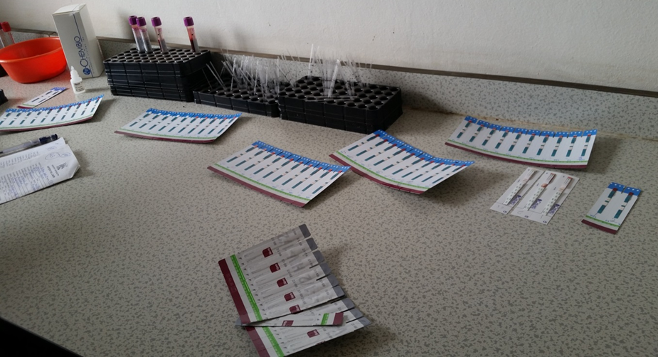
2.2

Slide 7
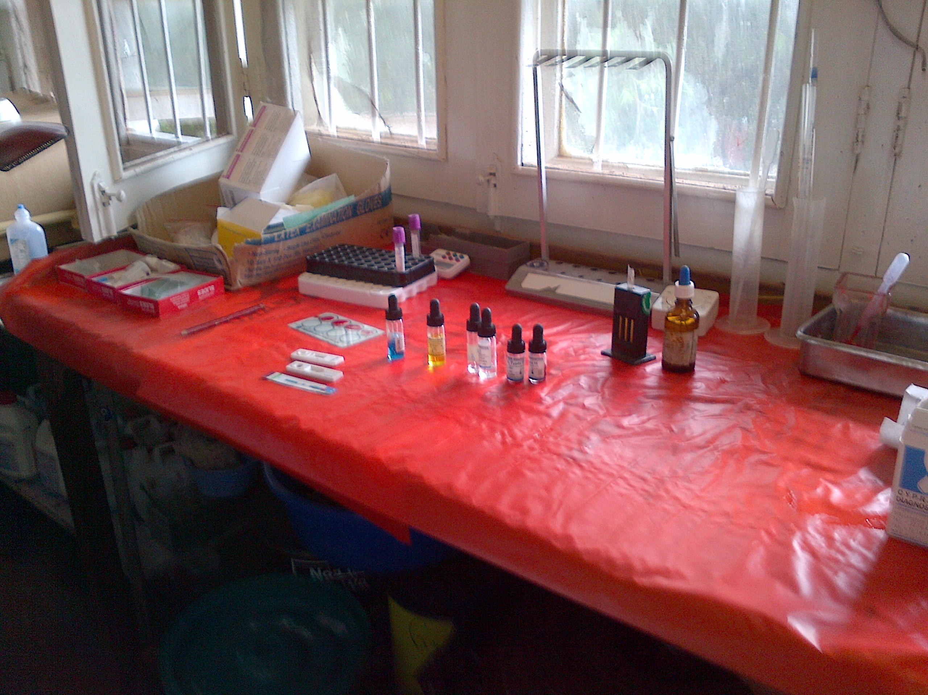
2.3

Slide 8
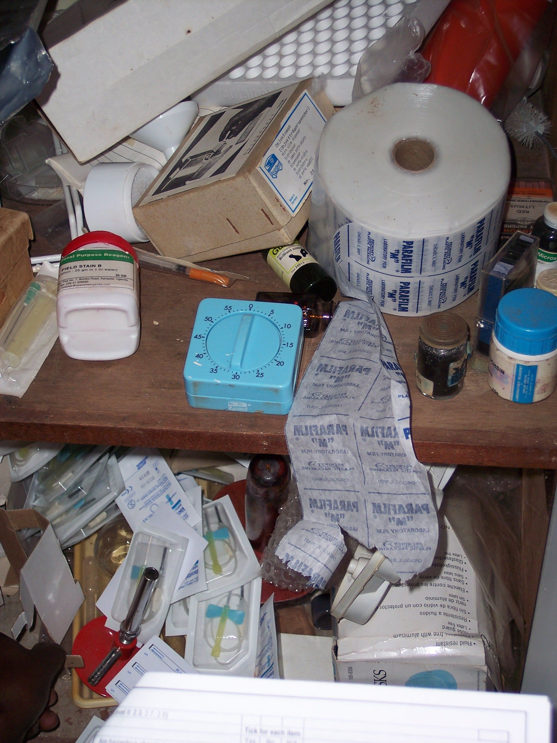
2.5

Slide 9
Safety
The testing sites implements infection prevention and control processes.

Slide 10
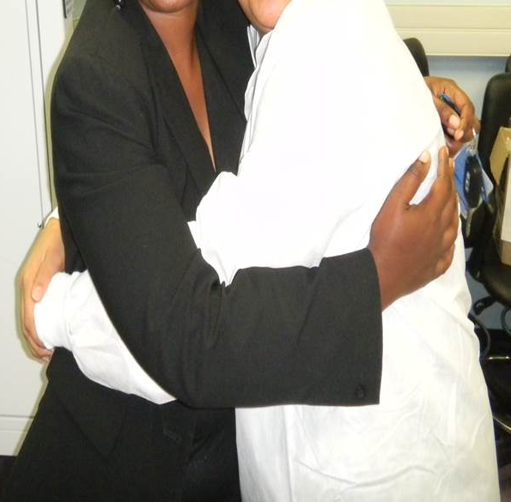
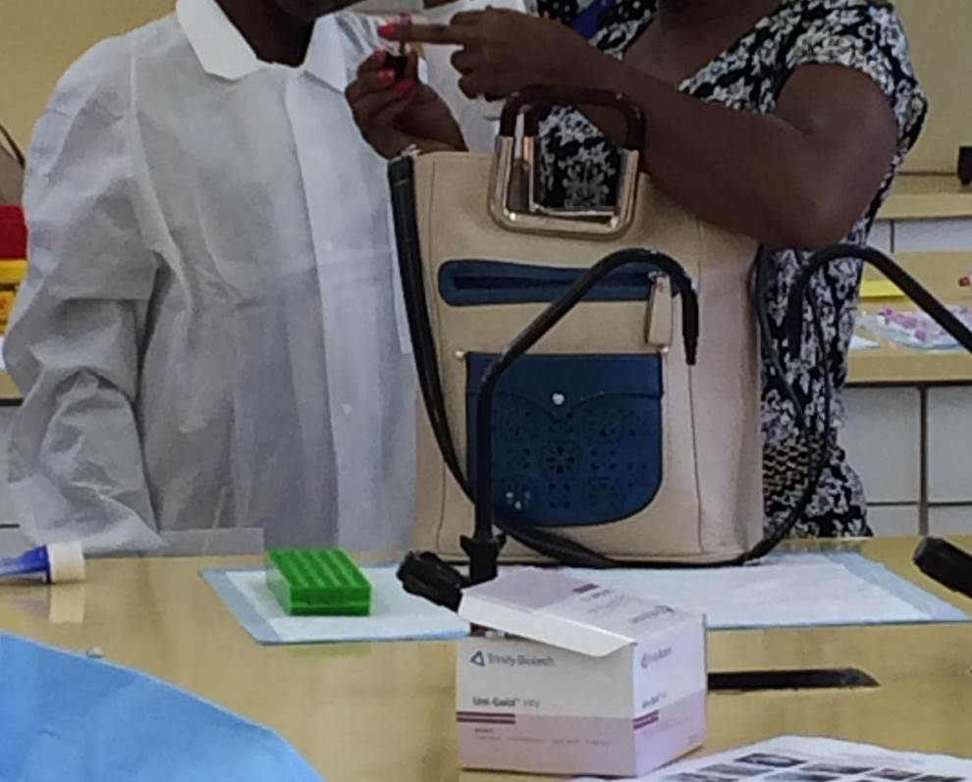
3.3

Slide 11
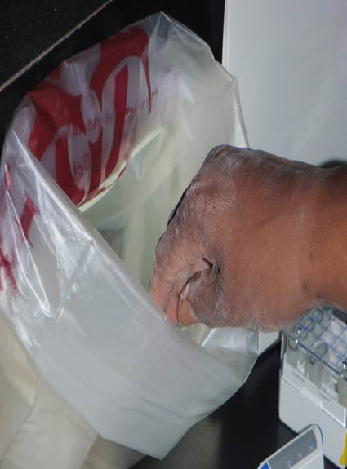
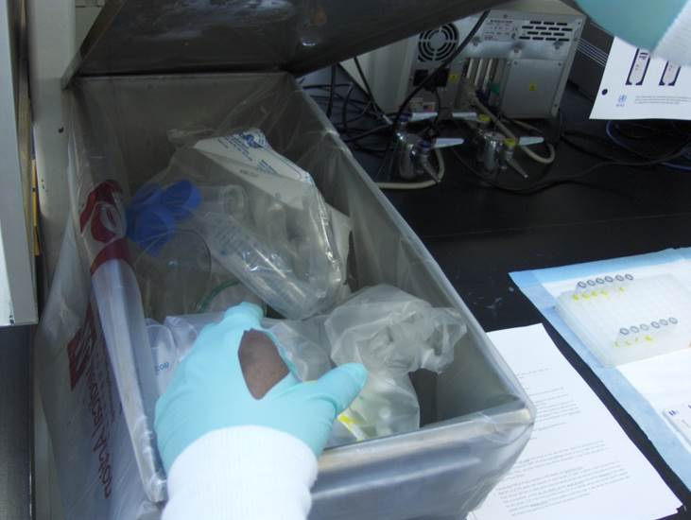
3.4

Slide 12
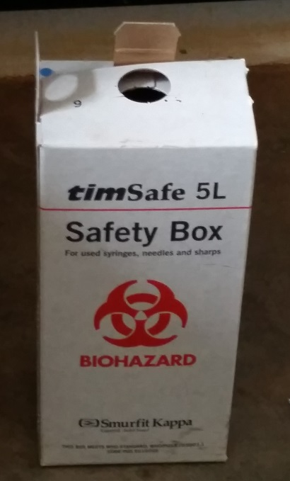
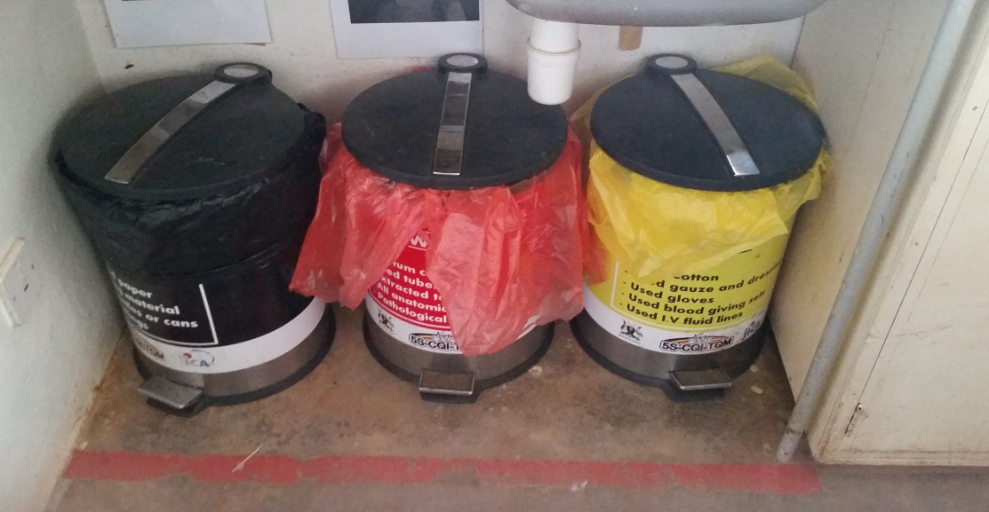
3.9a

Slide 13
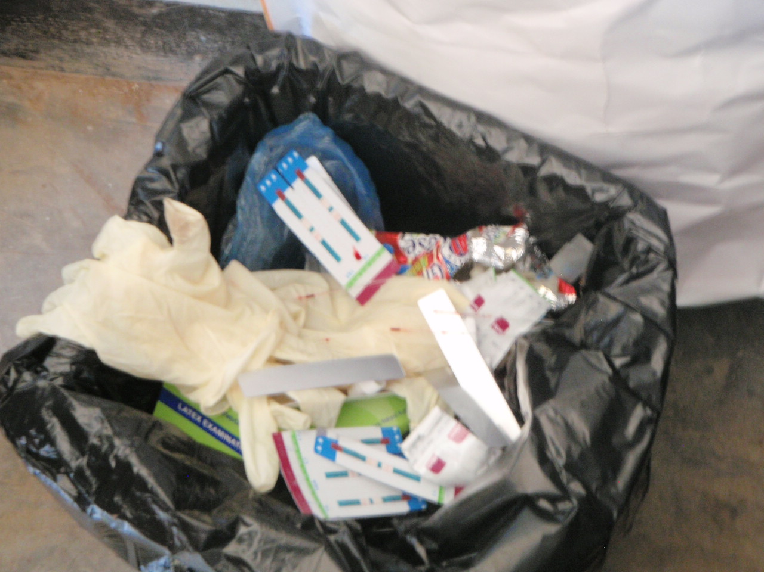
3.9b

Slide 14
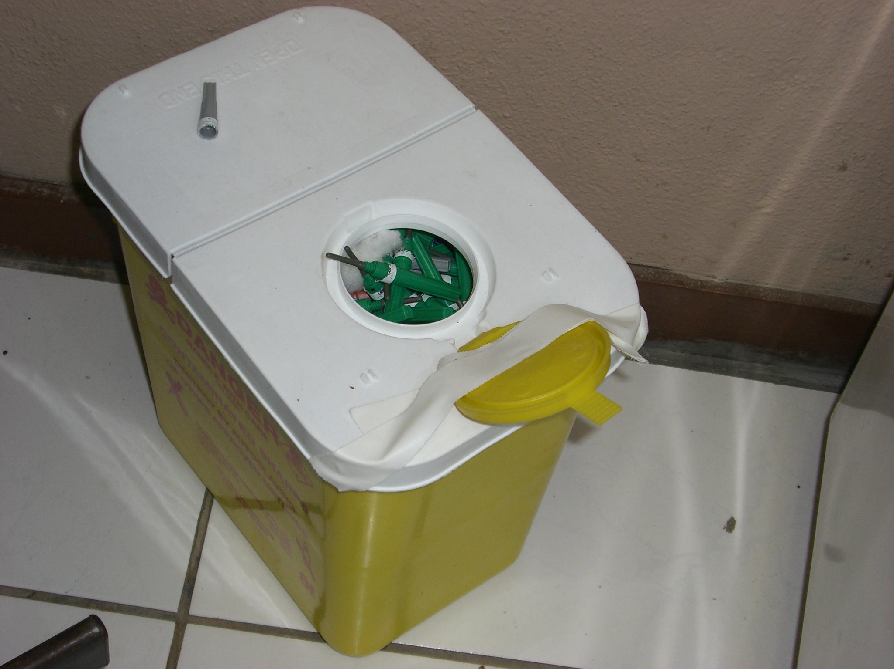
3.10

Slide 15
Pre-testing phase
Specimen collection and adequate supplies

Slide 16
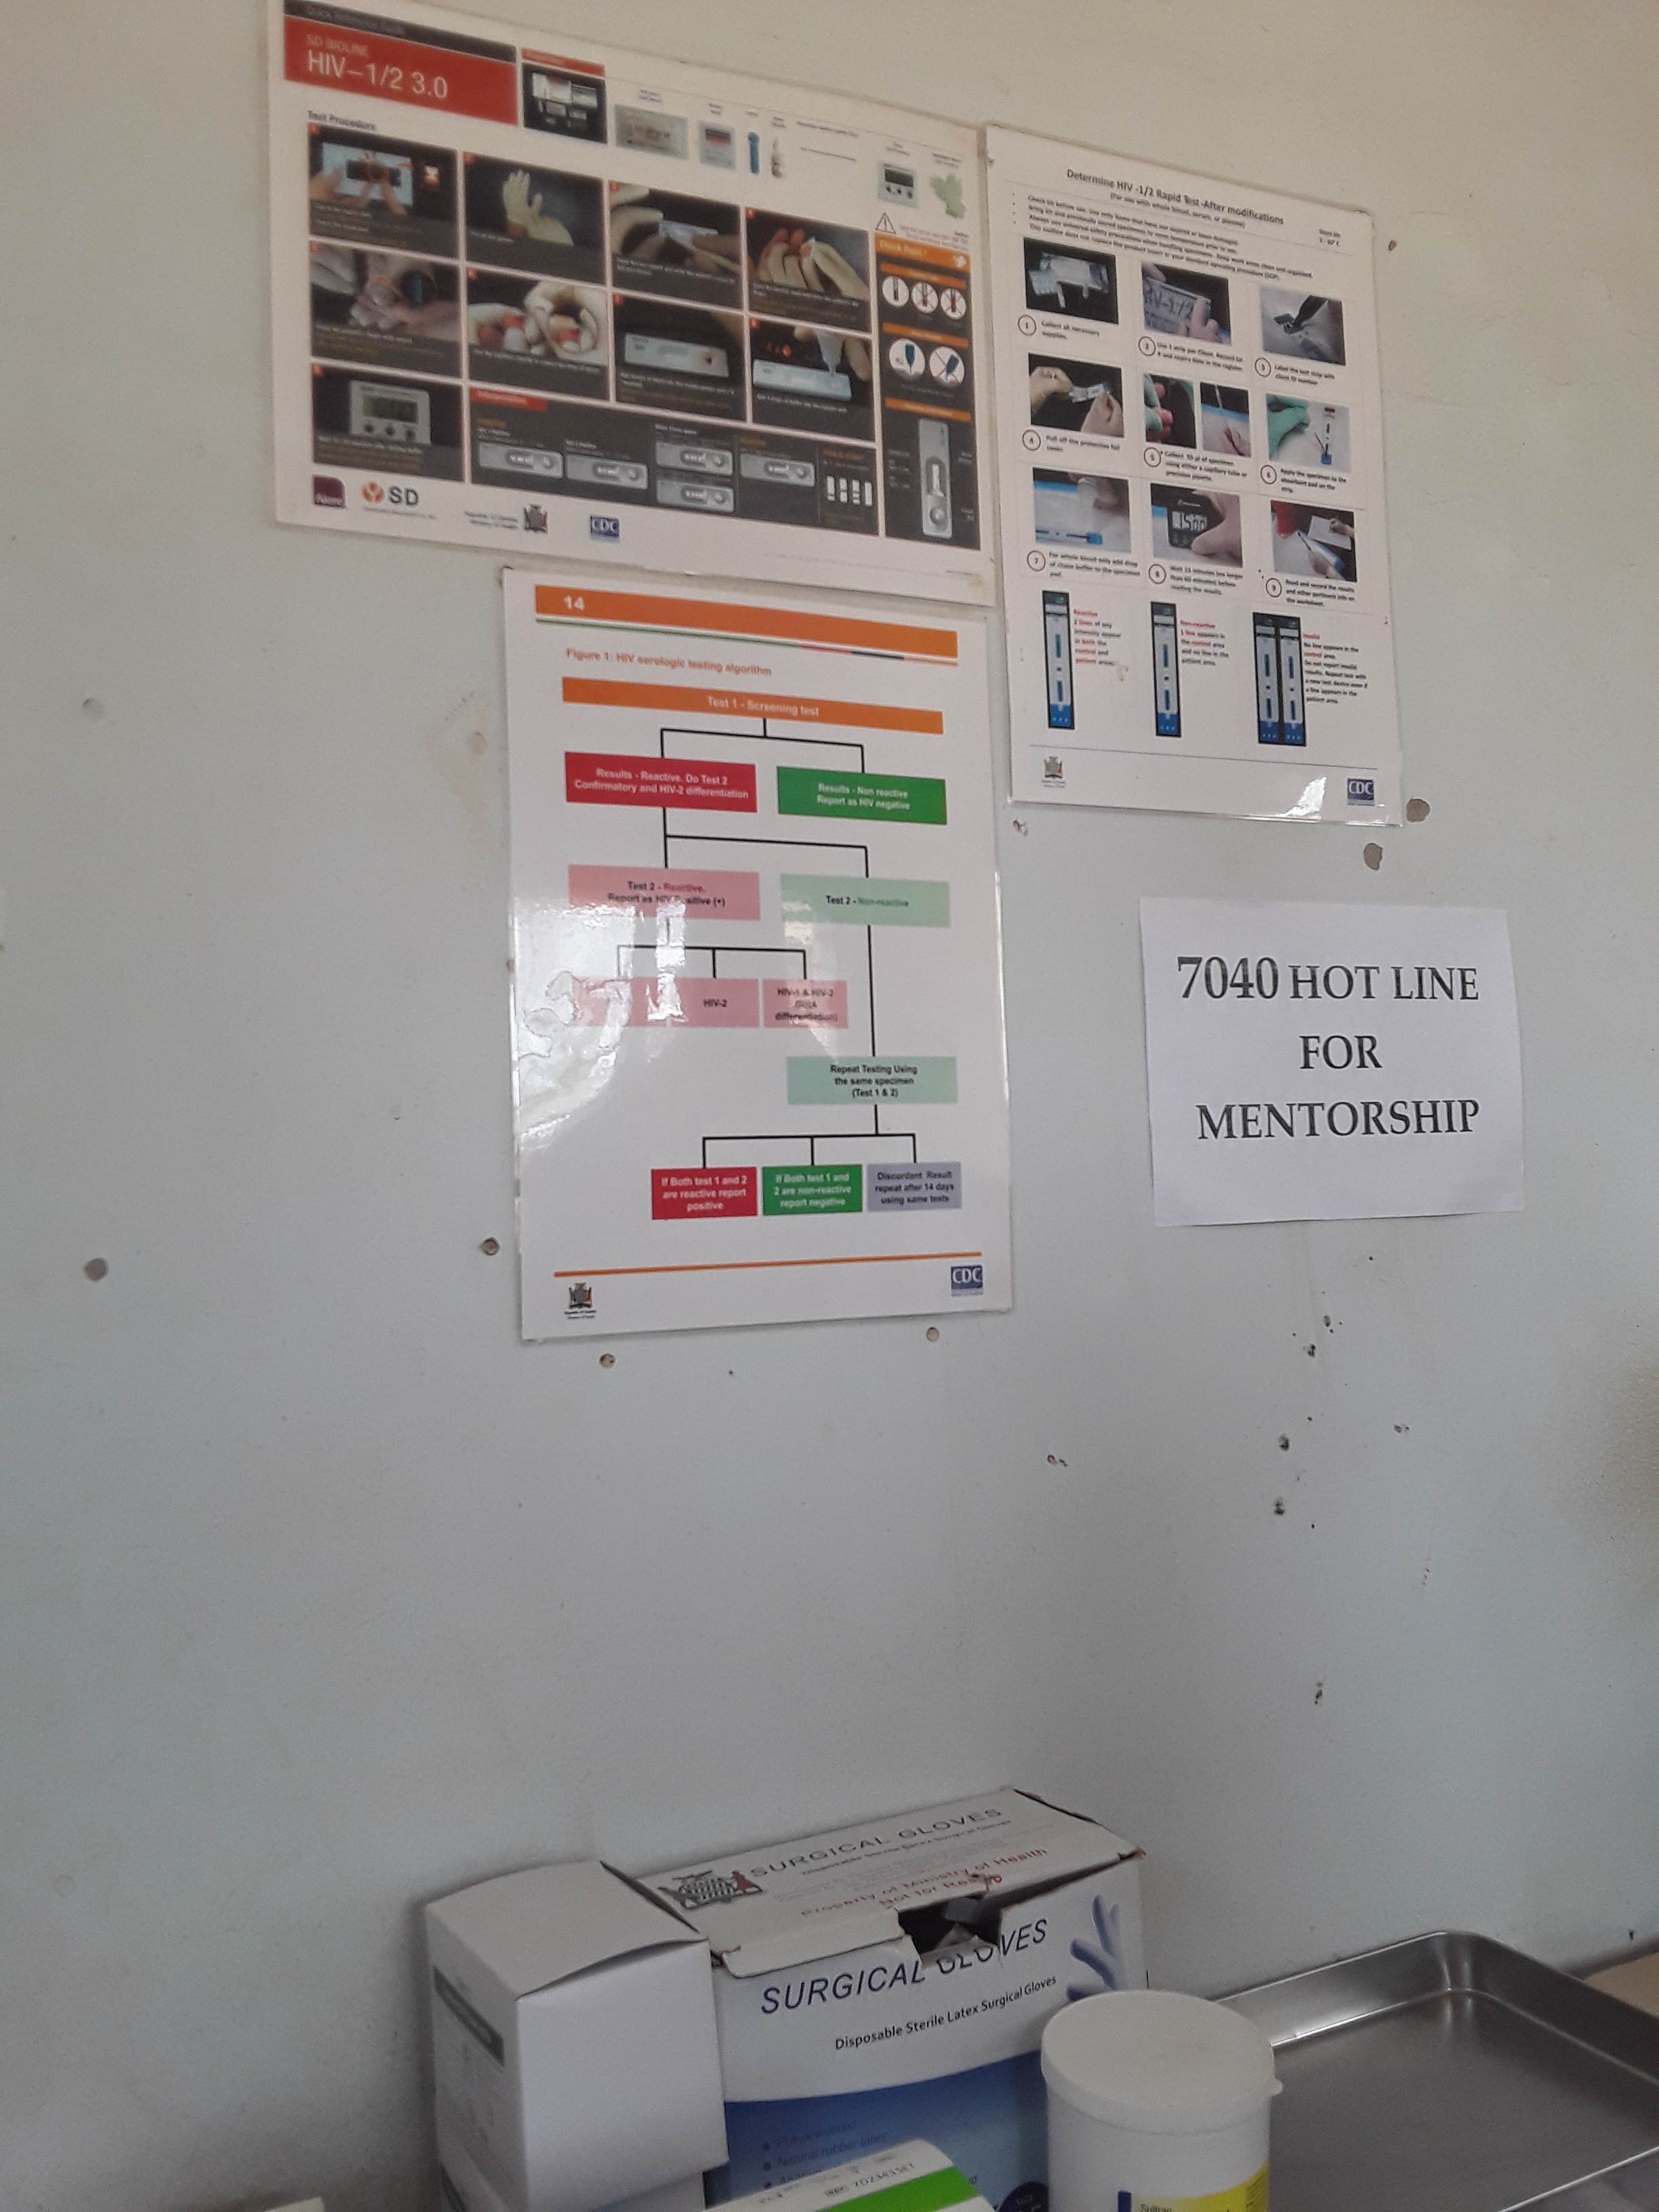
4.3

Slide 17
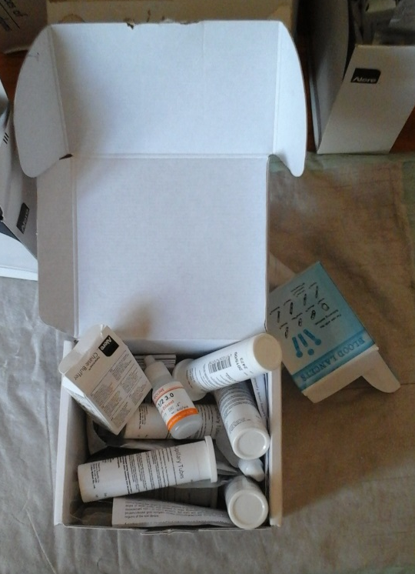
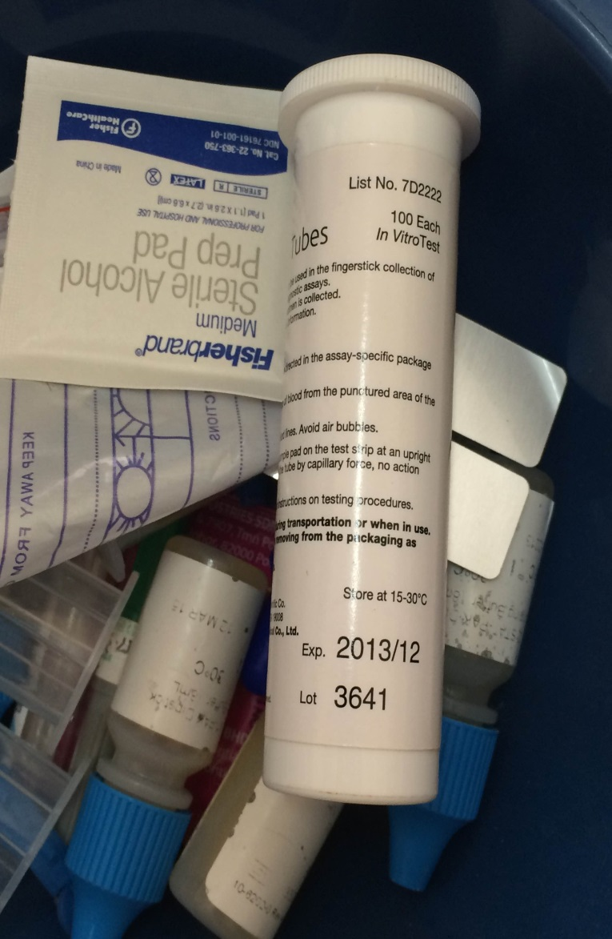
4.7a
4.7b

Slide 18
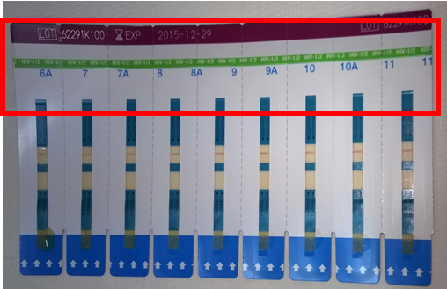
4.13

Slide 19
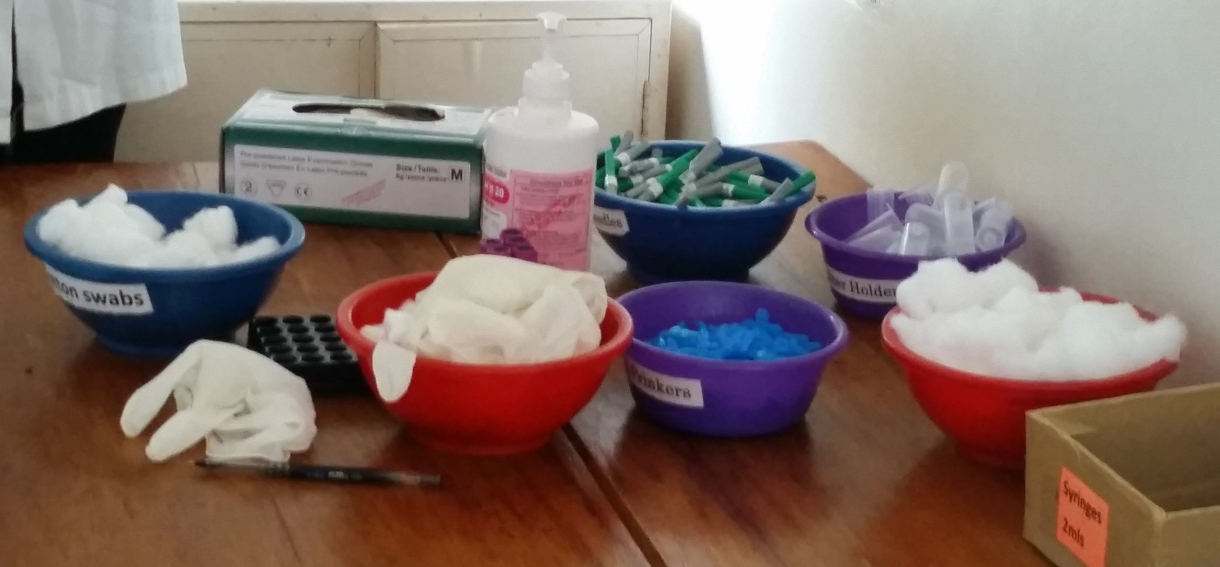
4.11
Phlebotomy supplies
Lancets

Slide 20
Testing phase
All safety and testing procedures are implemented during throughout testing

Slide 21
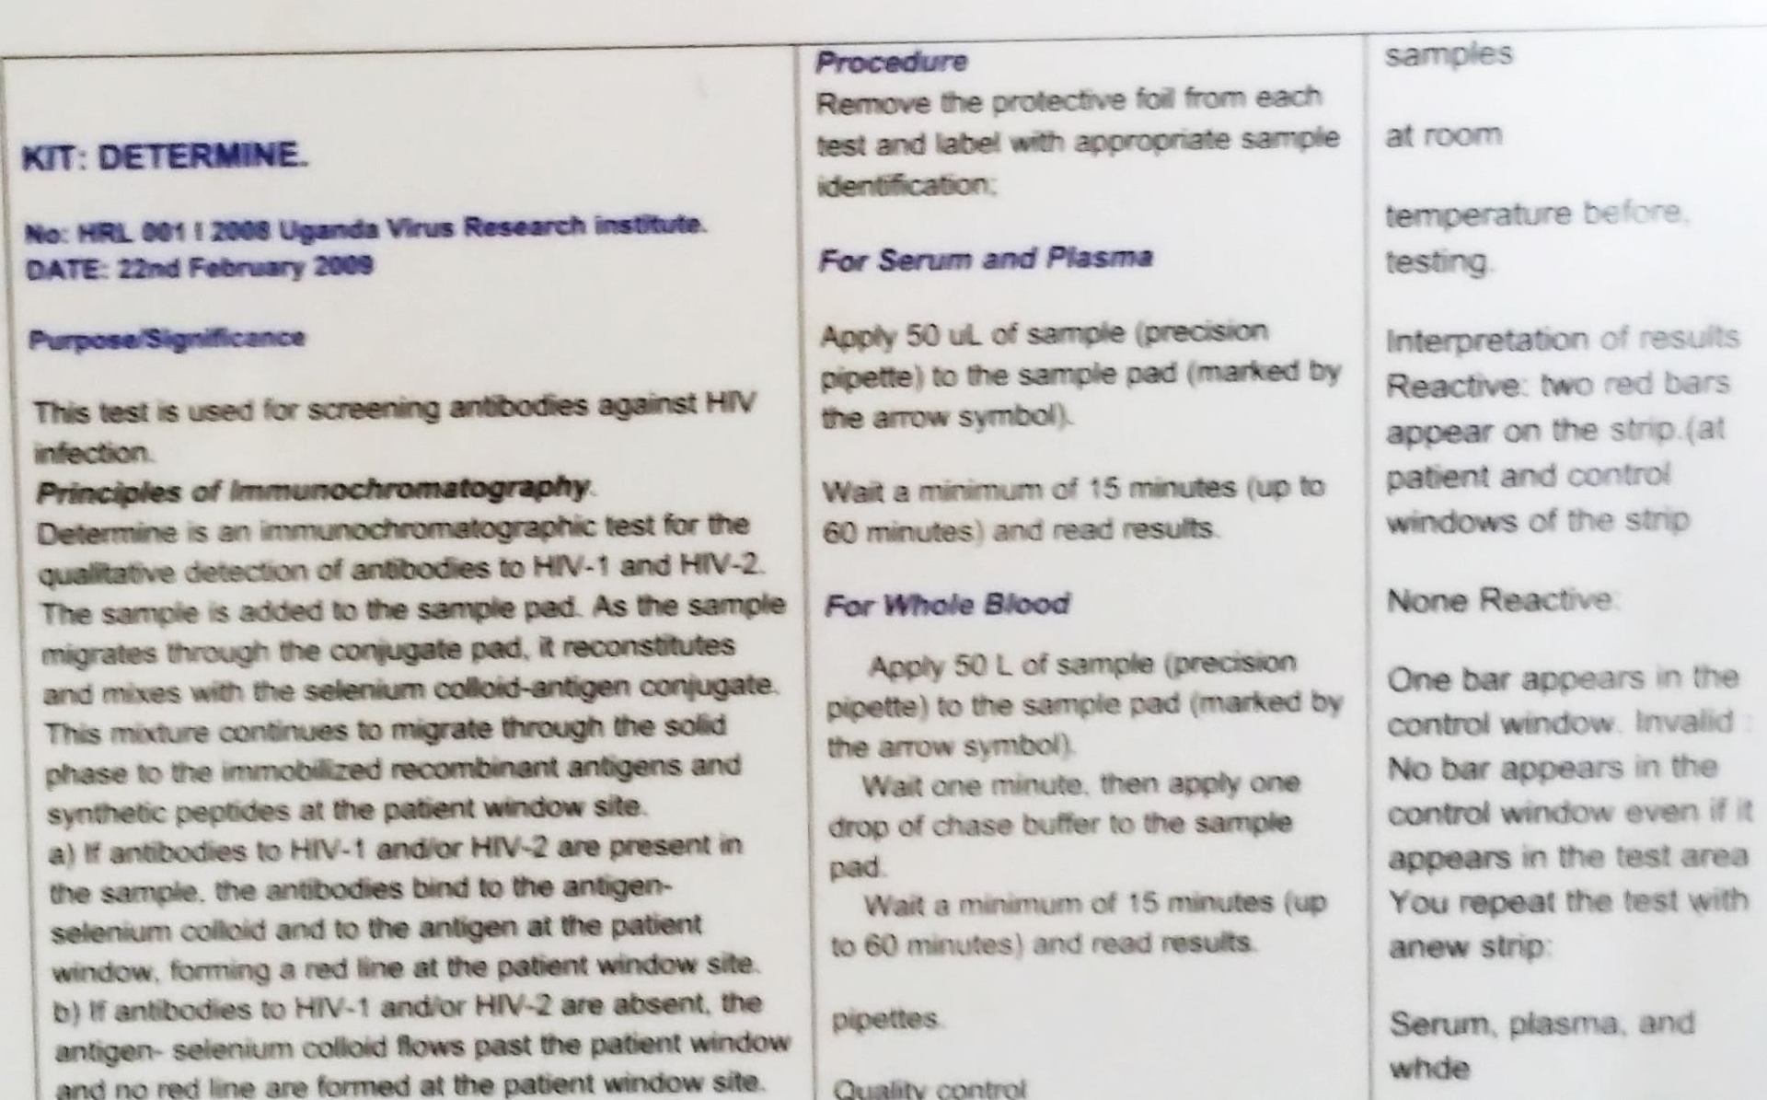
5.1

Slide 22
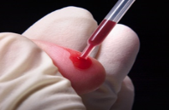
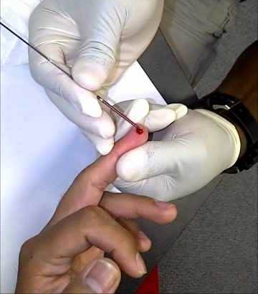
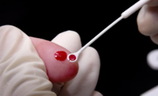
5.3

Slide 23
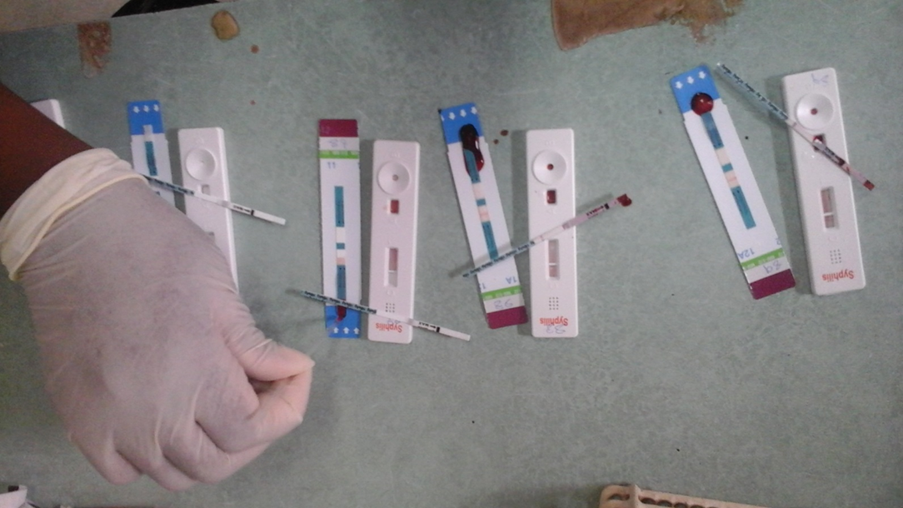
Same collection device for 3 different RT
5.4
1
2
3
Test devices not
labelled
Upside down
devices

Slide 24
Post-testing phase
Documents and records

Slide 25
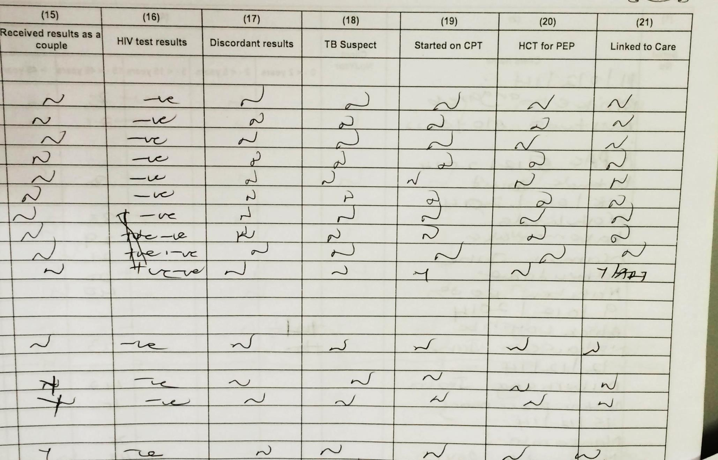
6.1/6.2

Slide 26
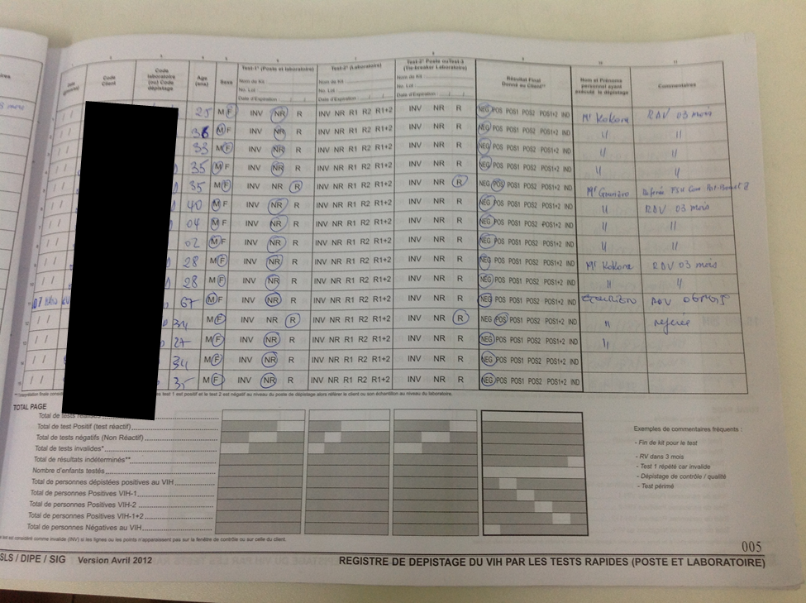
6.2/6.3

Slide 27
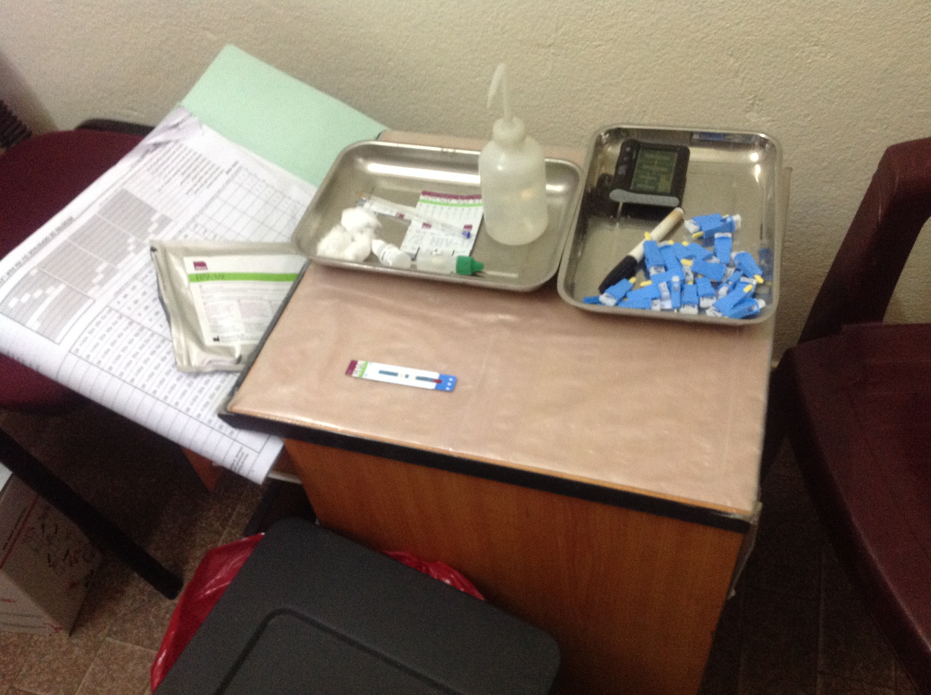
6.7
Client sits here

